Slide 1
TRIANGLE PROGRAM
Presented By:-
G Sai Anirudh
Intern-17

Slide 2
Contents
Below are some contents in the triangle program:-
1. Requirements/Inputs
2. Conditions
3. Execution
4. Results for Testcases
5. Test Code
6. Expected/Actual Outputs

Slide 3
Requirements of Triangle Program
A Triangle has three sides those are treated as inputs of this program.
Number of Sides are:-
First Side can be input 1 => a
Second Side can be input 2 => b
Third Side can be input 3 => c

Slide 4
Conditions of Triangle Program
A Triangle has many types those are implemented in different statements of this program.
Types of Triangles are:-
Equilateral Triangle -> a=b=c
Isosceles Triangle -> a!=b=c or a=b!=c or a!=c=b
Scalene Triangle -> a!=b!=c or a+b>=c or a+b<=c

Slide 5
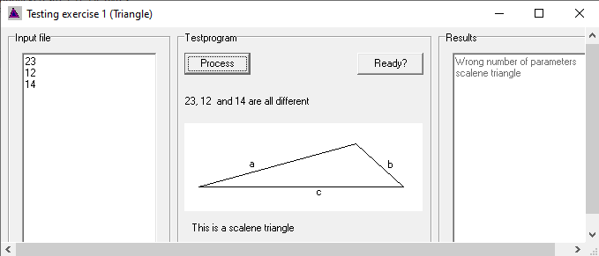
Execution of Triangle Program
This program can be executed by the below software with the execution file of triangle.exe

Slide 6
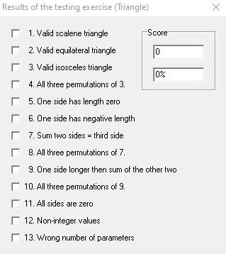
Results for Testing Triangle

Slide 7
Code for Triangle Program
Program Code:-
if(a==b && b==c && a==c)
"Equilateral Triangle";
else if(a==b && a==c && b!=c)
"Isosceles Triangle";
else if(a!=b && b!=c && a!=c)
“Scalene Triangle”;
else
“Invalid”;

Slide 8
Expected Outputs for Triangle Program
Input1 (A) | Input2 (B) | Input3 (C) | Expected Output
3 | 3 | 3 | Equilateral Triangle
3 | 3 | 6 | Isosceles Triangle
3 | 4 | 5 | Scalene Triangle
1 | 2 | 0 | Invalid
10 | 10 | 10 | Equilateral Triangle
13 | 14 | 15 | Scalene Triangle
12 | 18 | 12 | Isosceles Triangle

Slide 9
Actual Outputs for Triangle Program
Input1 (A) | Input2 (B) | Input3 (C) | Expected Output | Actual Output | PASS/FAIL
3 | 3 | 3 | Equilateral Triangle | Equilateral Triangle | PASS
3 | 3 | 6 | Isosceles Triangle | Isosceles Triangle | PASS
3 | 4 | 5 | Scalene Triangle | Scalene Triangle | PASS
1 | 2 | 0 | Invalid | Scalene Triangle | FAIL
10 | 10 | 10 | Equilateral Triangle | Equilateral Triangle | PASS
13 | 14 | 15 | Scalene Triangle | Scalene Triangle | PASS
12 | 18 | 12 | Isosceles Triangle | Isosceles Triangle | PASS

Slide 10
THANK YOU

